Slide 1

LIDAR/Radar & Camera Fusion
Autonomous Vehicles – ECE-6460
Group 6 - Fall 2022
Alex Tyshka Matthew Bellafaire Pourya Shahverdi

Slide 2
Overview
The goal of this project is to create a 3D object tracker that is capable of tracking and identifying objects.
Object locations are tracked by LIDAR/Radar fusion
Object identification is performed by YOLO image classification
Autonomous Vehicle Systems II - ECE6460

Slide 3
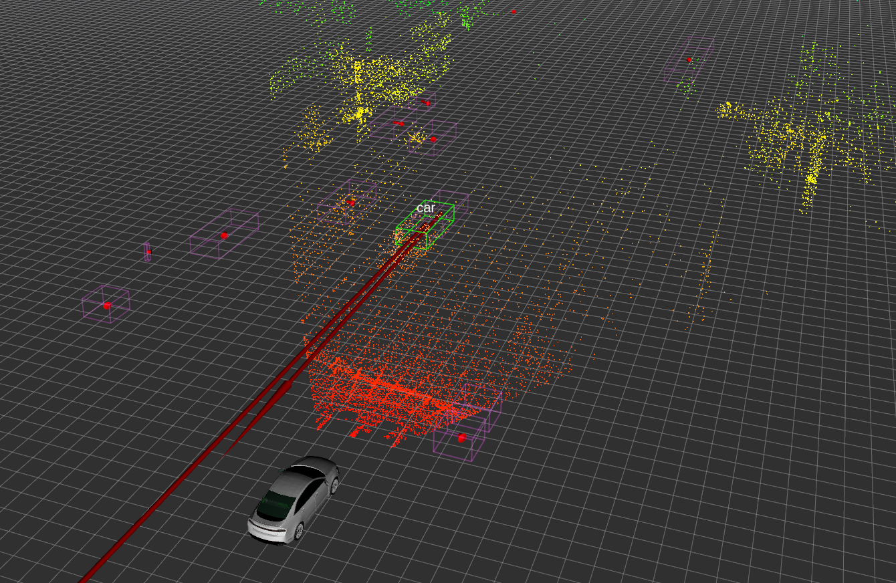
Overview
Both Lidar and Radar generate noisy boxes off the road
This project focuses on tracking only dynamic objects (e.g. vehicles)
Autonomous Vehicle Systems II - ECE6460

Slide 4
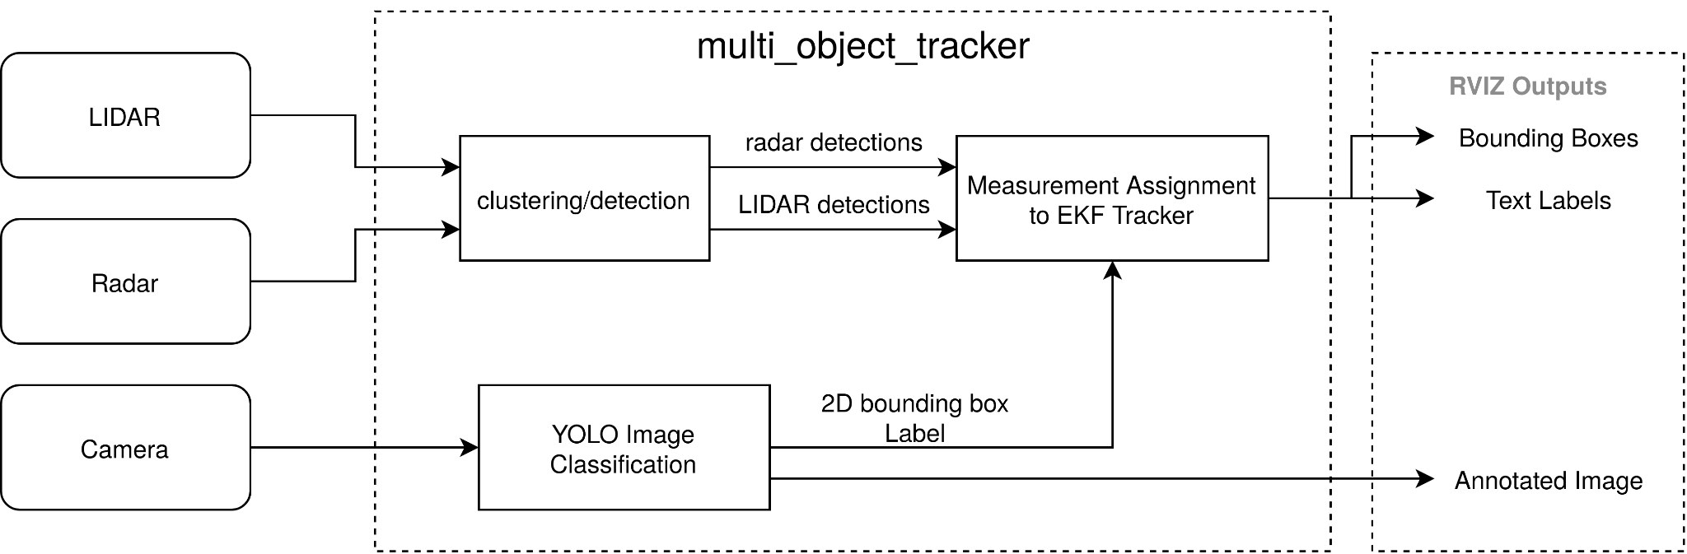
Overview
Autonomous Vehicle Systems II - ECE6460

Slide 5
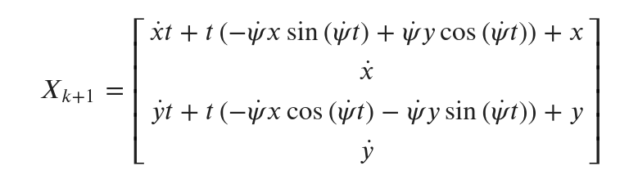
Extended Kalman Filter
The EKF was adapted from the object tracker in Homework 4.
The state transition was adapted to compensate for the tracked objects movement when the vehicle is turning.
Autonomous Vehicle Systems II - ECE6460

Slide 6
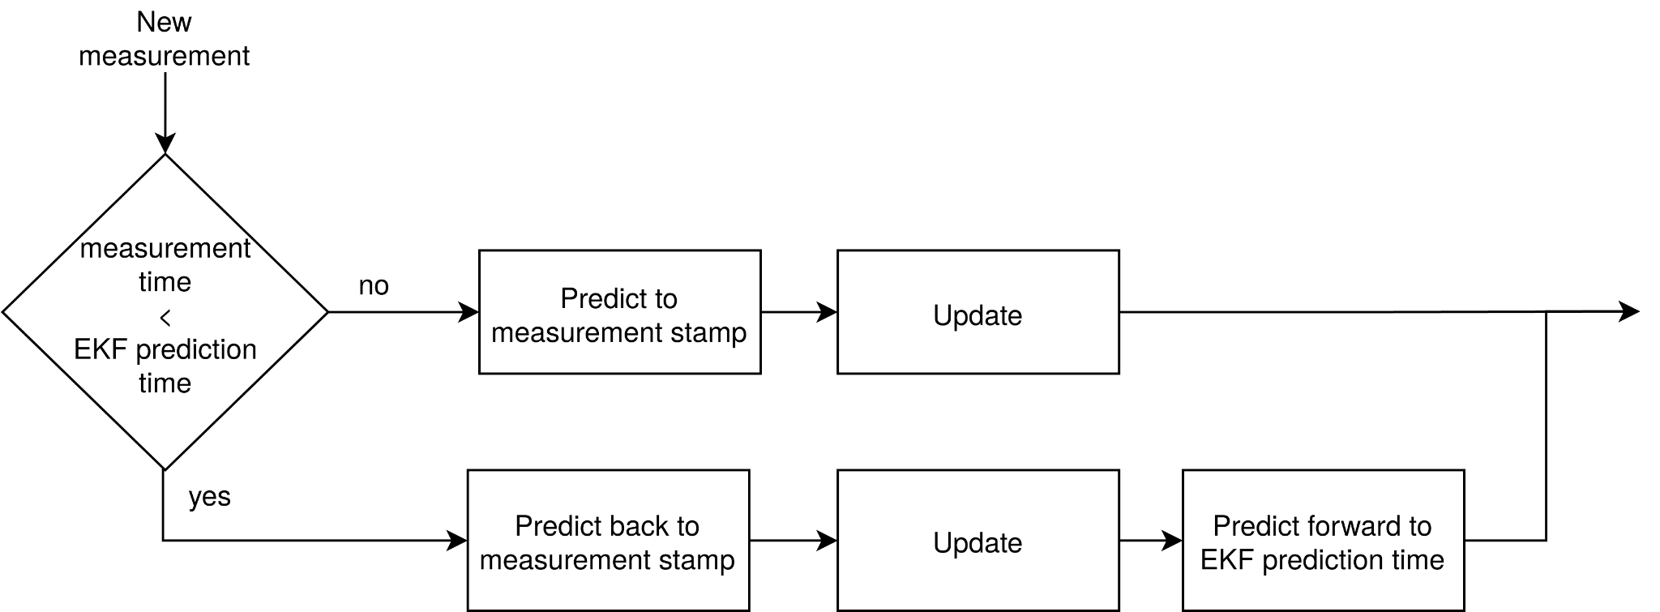
Sensor Fusion
LIDAR and radar are not time synced
The EKF projects back to the time of the measurement before incorporating the information. Then project the state forward again.
Autonomous Vehicle Systems II - ECE6460

Slide 7
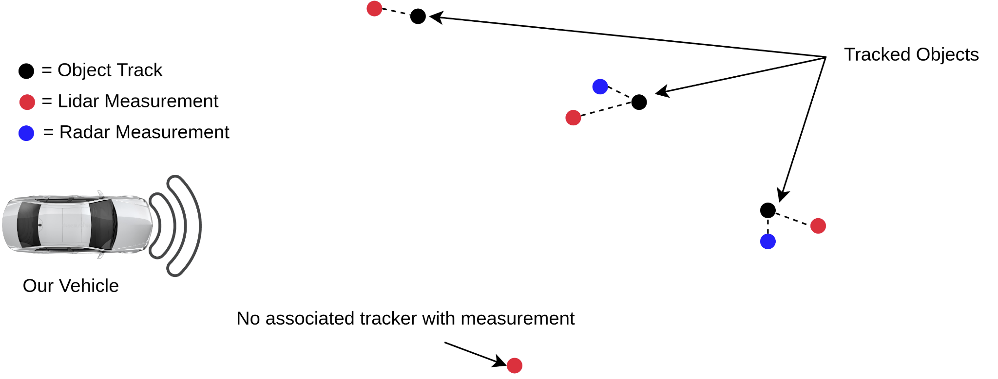
Radar Filtering
Radar objects are filtered out if they
Do not correspond to a YOLO object and
Do not have a velocity
Autonomous Vehicle Systems II - ECE6460

Slide 8
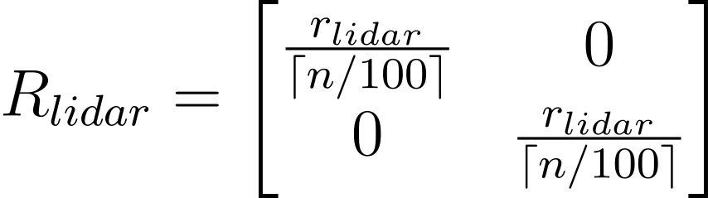
Sensor Noise Calculation
For the LIDAR the sensor noise is adaptive to the number of points in the point cloud. The R matrix is calculated as:
where n = number of points, and r_{lidar} is the base noise value for the lidar information.
Autonomous Vehicle Systems II - ECE6460

Slide 9
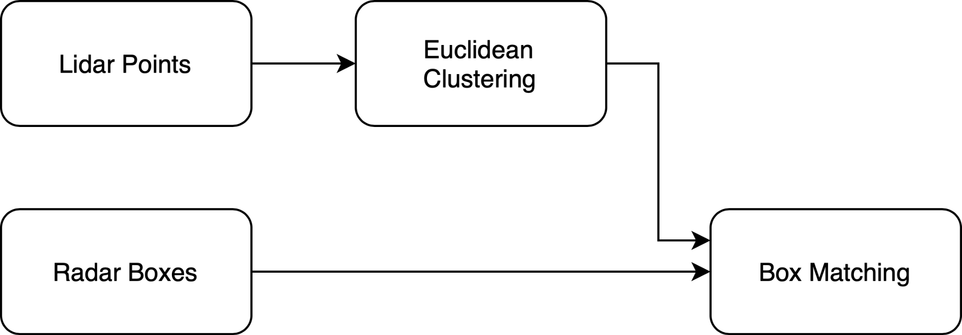
LIDAR Segmentation (original)
Original lidar approach used Euclidean clusters from HW3
Lidar boxes noisy (objects frequently split/merge together)
Autonomous Vehicle Systems II - ECE6460

Slide 10
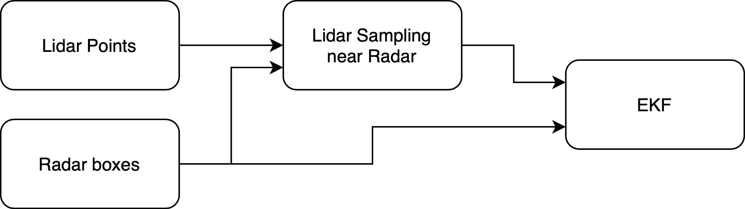
LIDAR Segmentation
LIDAR segmentation utilizes radar information to more efficiently perform clustering
LIDAR points sampled near radar measurements
Bottom 20% of the cloud for each object is removed
LIDAR object centroids update the EKF
Autonomous Vehicle Systems II - ECE6460

Slide 11
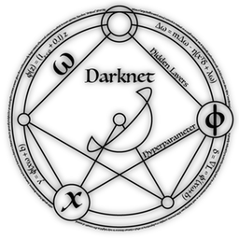

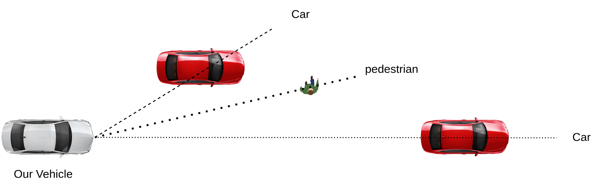
Object Identification
Objects are identified through YOLO image classification using the camera feed from the vehicle.
Autonomous Vehicle Systems II - ECE6460

Slide 12
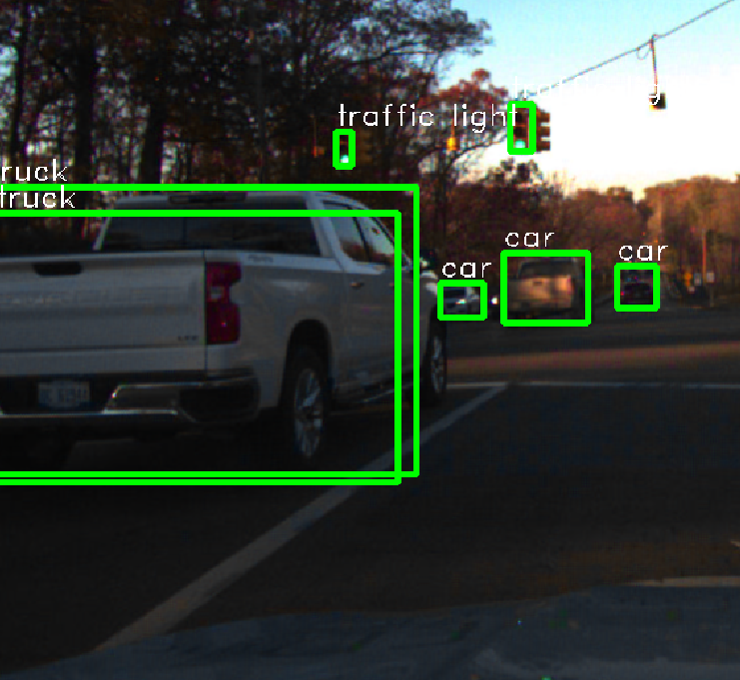
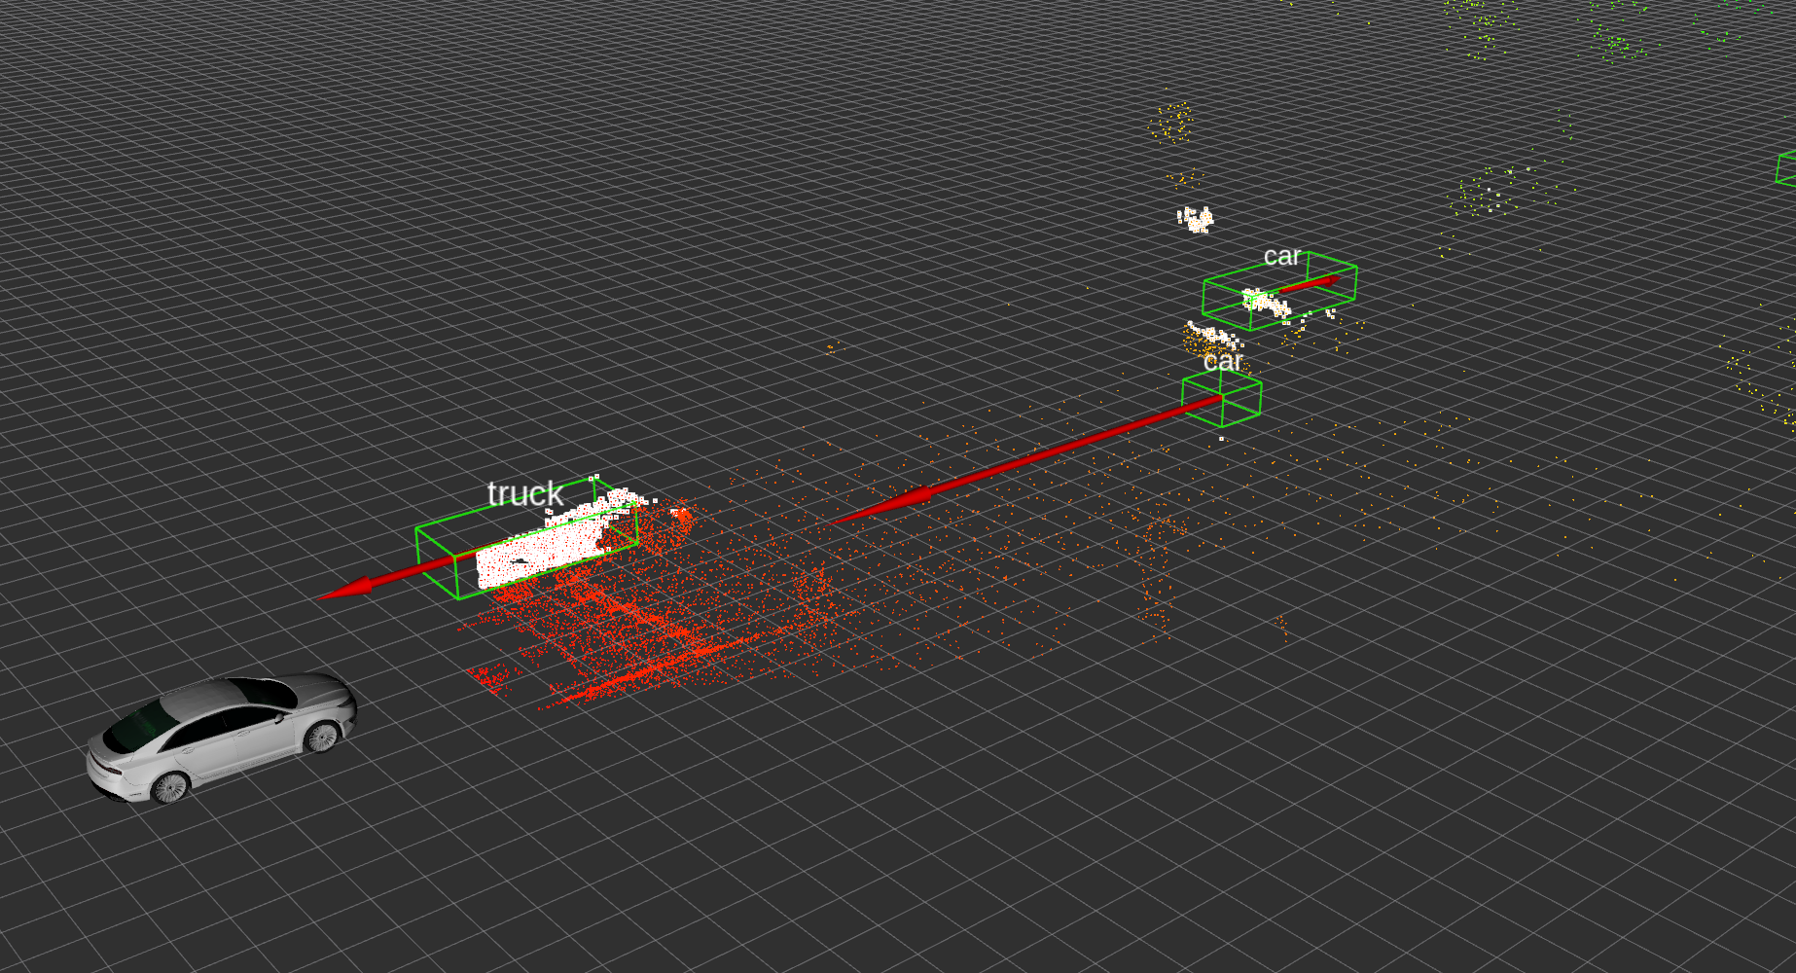

Object Correlation
Objects in the camera frame are correlated to the 3D objects tracked by the system using intersection over union (IoU)
Autonomous Vehicle Systems II - ECE6460

Slide 13
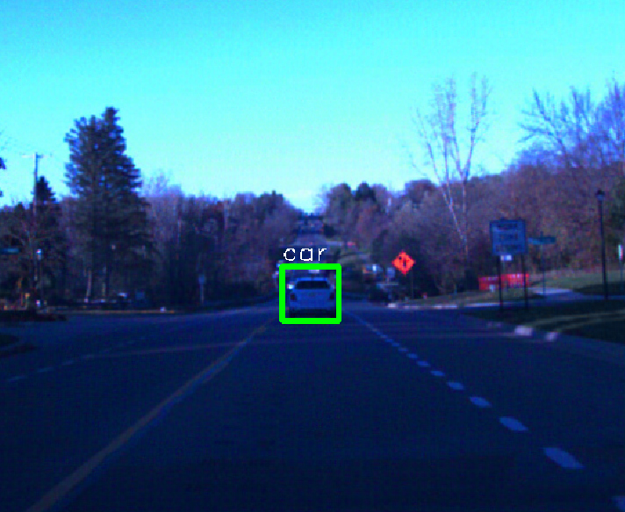
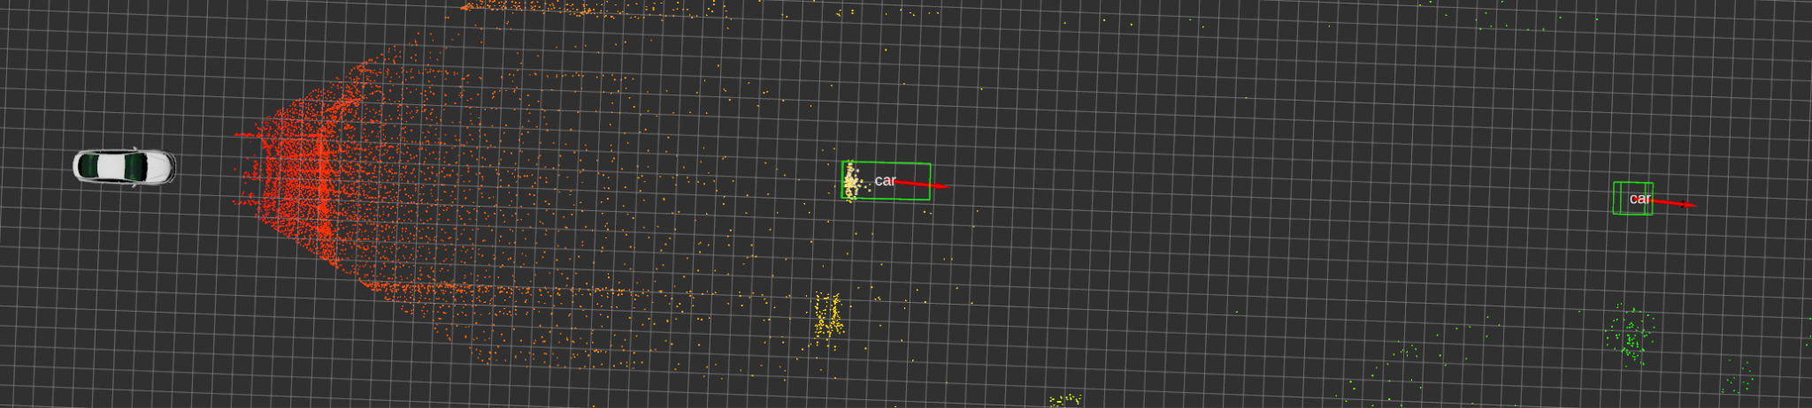
Object Correlation
3D objects projected to a 2D plane & aligned with the detections of the YOLO Classification.
The class labels are stored in the object
Object labels persist after they have left the camera view:
Autonomous Vehicle Systems II - ECE6460

Slide 14

Demonstration
Running system on road_data_sample_with_labels.bag
Tracks and labels vehicles in the environment
Merges lidar and radar information
Autonomous Vehicle Systems II - ECE6460

Slide 15
Challenges
Radar/LIDAR positions do not match perfectly
Timing issues with Radar readings vs LIDAR, needed compensation in filter
Ideal object detection pipeline would fuse raw LIDAR, Radar, and camera before box discretization, e.g. with a neural network
Autonomous Vehicle Systems II - ECE6460

Slide 16


